Slide 1
V-Model Presentation
Presentation for the class of ESOF - 3MIEIC05
T2 - Software Processes
Duarte Nuno Esteves André Lima de Carvalho– up201503661@fe.up.pt
João Álvaro Cardoso Soares Ferreira – up201605592@fe.up.pt
João Augusto dos Santos Lima – up201605314@fe.up.pt

Slide 2
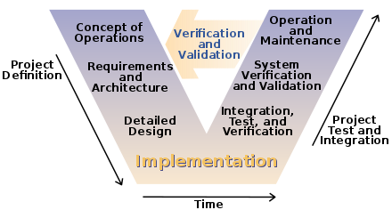
What Is The V-Model?

Slide 3
What Is The V-Model?
V-Model is a strict model for software development developed as an extension from the Waterfall model.
It can be summarized by its shape, a V:
The left side has the verification stages.
The right side is comprised of the validation stages.
At the point where both sides meet, at the bottom of the V, code is developed and implemented.
The tests on the right side are developed at the same time as the respective concepts on the left side.

Slide 4
Origin of the V-Model
The V-Model, or Vee Model, was created by the German government in the 1990s to manage project development in their defence department.
It was developed as a counter-part to the PRINCE2 model, and is to this day still used by the UK and USA’s governments.

Slide 5
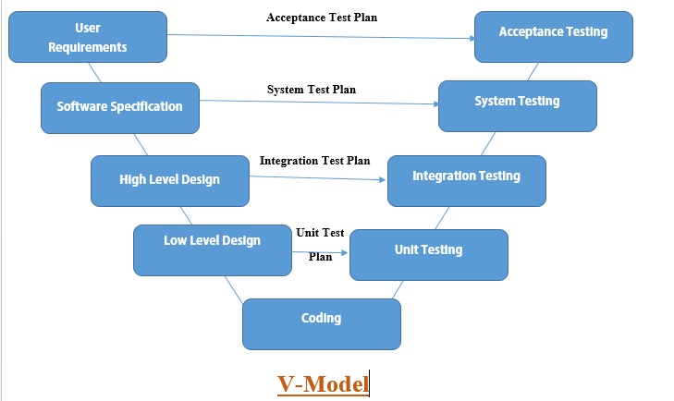
The Stages

Slide 6
The Stages – Left Side (Verification Stages)
User Requirements – Where the user’s needs and respective solutions are determined.
System Design – Where the techniques and methods that will be needed to accomplish the solutions are decided.
Architecture Design – Where the high-level concepts for the code are designed, making use of tools such as class diagrams.
Module Design – Where the functions to be developed in the implementation stage are defined.

Slide 7

Implementation
The middle-point of the V and usually the most time consuming stage, this is where the code is developed.

Slide 8
The Stages – Right Side (Validation Stages)
Unit Testing – the goal of this phase is to get rid of bugs at a code level, being the lengthiest of the testing stages.
Integration Testing – checks if all components are working together properly.
System Testing – often developed while in contact with the consumer, these tests verify if the entirety of the system is working as expected and as was designed.
Acceptance Testing – the last overall stage, it checks if all the needs of the client are met.

Slide 9

Pros and Cons

Slide 10
Pros
Simple to use and understand, especially for smaller projects.
Prevents extensive debugging, as all issues are discovered at an appropriate stage.
There’s an overwhelming amount of testing, documentation and stability due to the highly strict approach, leading to a more stable product.

Slide 11
Cons
Lacks flexibility and ways to respond to unexpected problems during development.
Promotes strictness and streamlining, sometimes overlooking creative solutions.
Issues with time constraints.
Ill-suited for continued support after launch (for example, with patches).
Due to how easy it is to understand at first, inexperienced developers might stick to its guidelines too much.

Slide 12

When to use the V-Model
The V-Model is ideal for projects where stability is a priority, at the cost of a higher budget and lengthier development time, along with a product that won’t need frequent patches.

Slide 13

Examples of V-Model Usage
The V-Model is frequently used in software for:
Healthcare
Military
Government

Slide 14
Sources
A Software Process Development, Assessment and Improvement Framework,for the Medical Device Industry - Dundalk Institute of Technology
What is V-Model? - airbrake.io
V-Model vs Scrum: Who Wins? - reqtest.com
Good Design Practice for Medical Device and Equipment - Cambridge University
Using V-Model for Testing - Carnegie Mellon University

